Slide 1



Facet
Disease (comorbidity)
penVirus

Slide 2




Analysing comorbidity
?
Analyse & annotate comorbidities from PubMed articles?
=> AMI
=> DISEASE dictionary
→ amidict → SPARQL (WIKIDATA QUERY SERVICE)
ICD - 10 codes

Slide 3

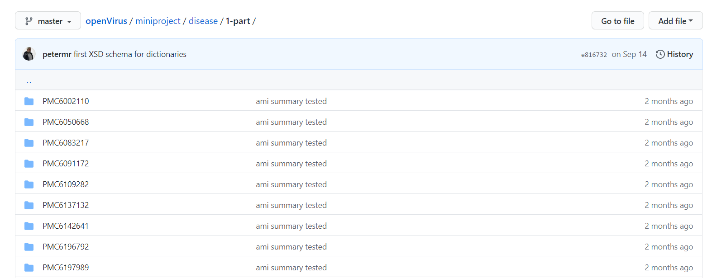
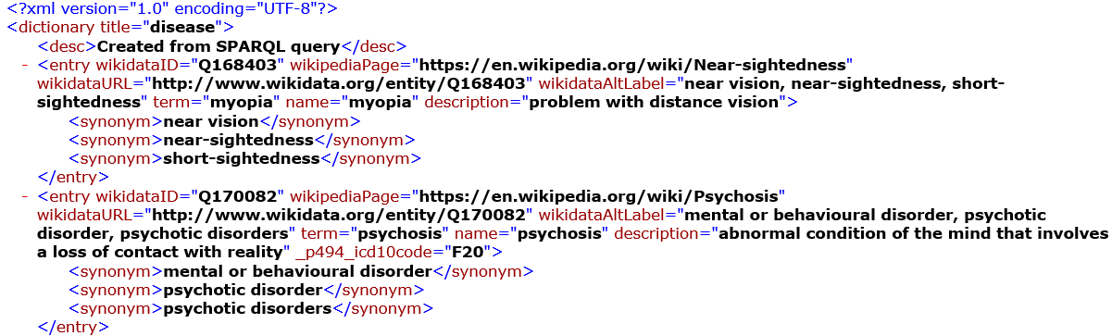
Mini-project (https://github.com/petermr/openVirus/wiki/miniproject:-viral-epidemics-and-disease)
Corpus (https://github.com/petermr/openVirus/tree/master/miniproject/disease)
Dictionary
(https://github.com/petermr/openVirus/tree/master/dictionaries/diseases)
950 PMCs from EPMC!

Slide 4
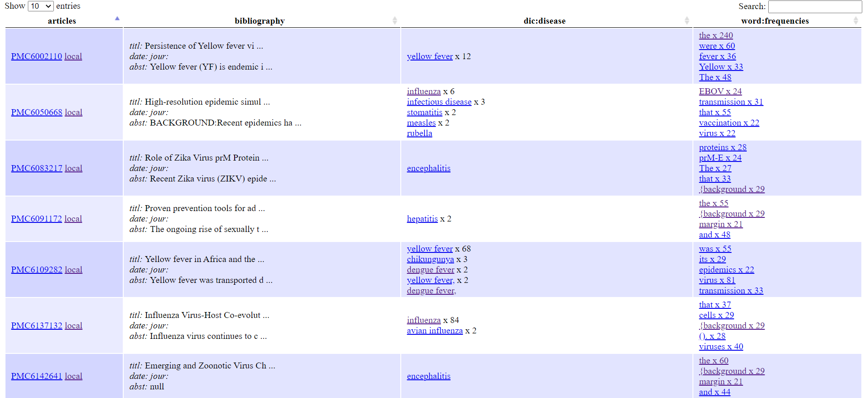
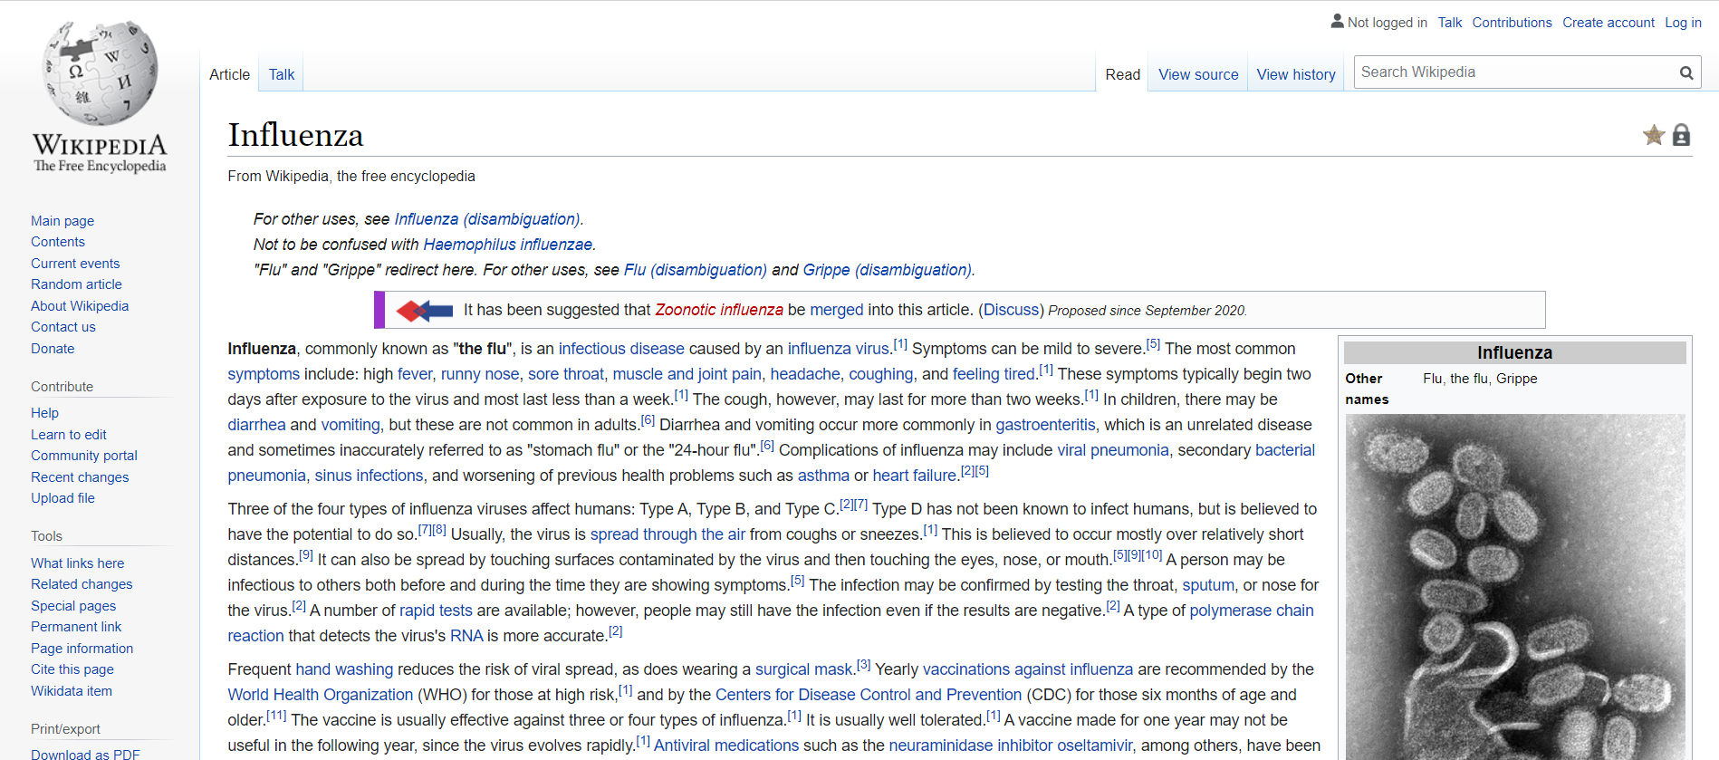
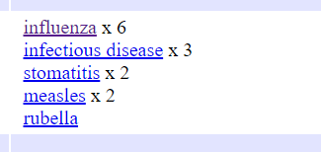
Wikipedia page! Wikidata!
DataTables .html file

Slide 5
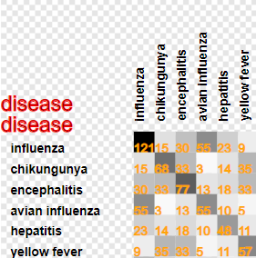
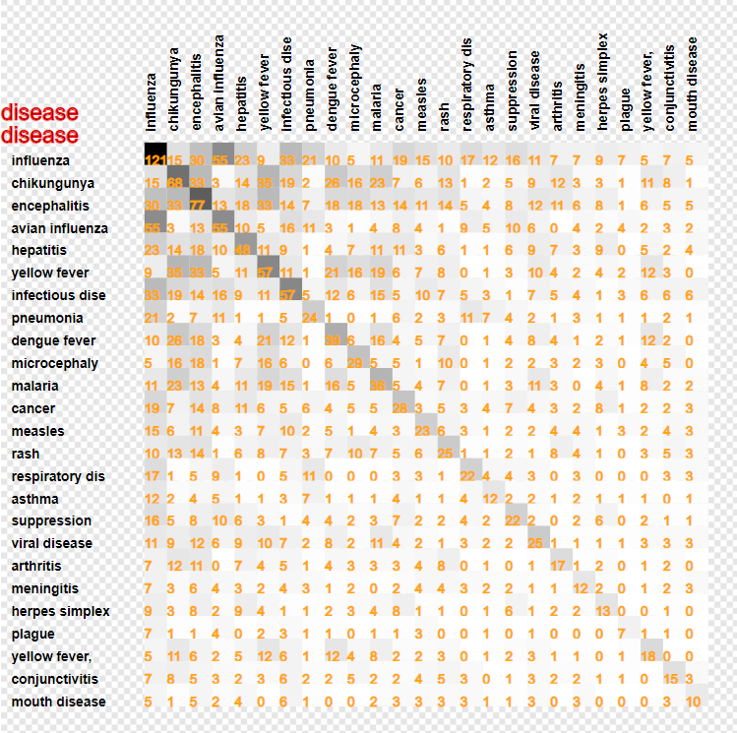
Co-occurrence of
words
Frequent disease
Influenza
Chikungunya
non-covid papers

Slide 6

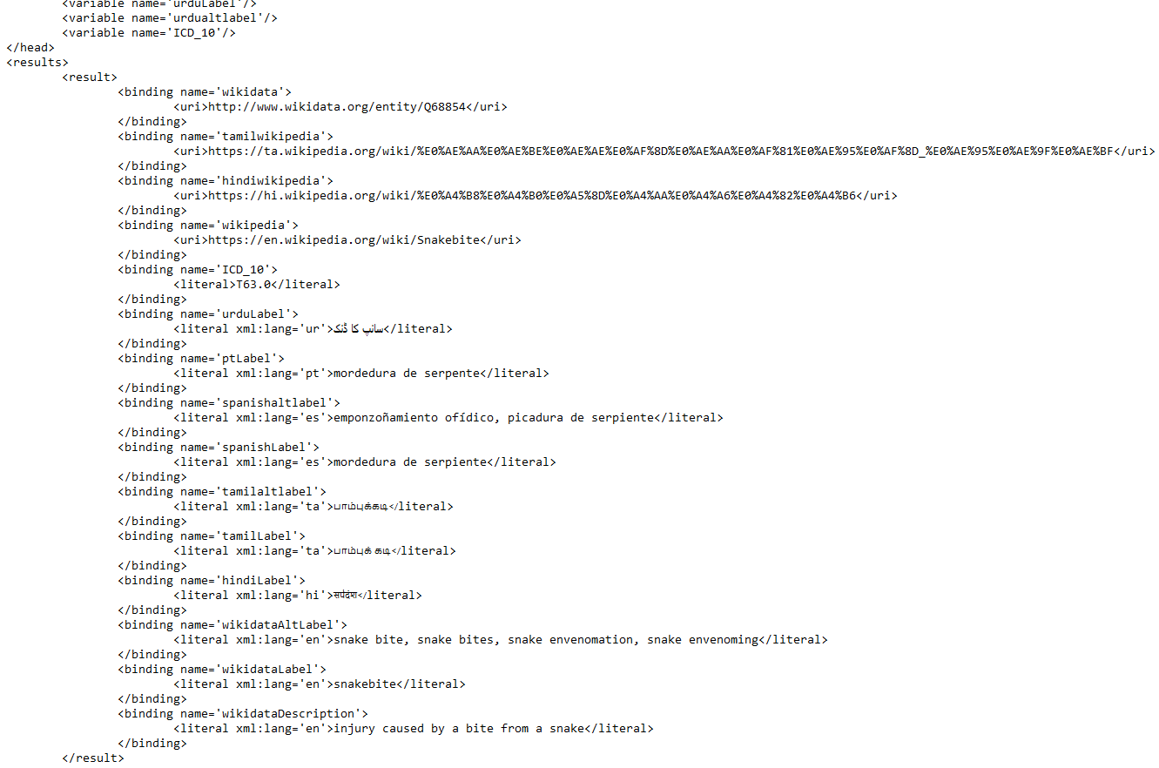
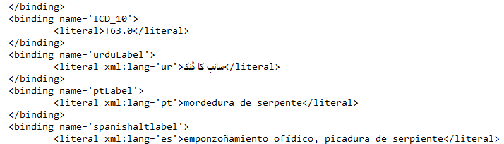
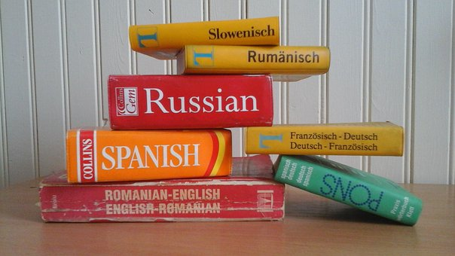
SPARQL file

Slide 7
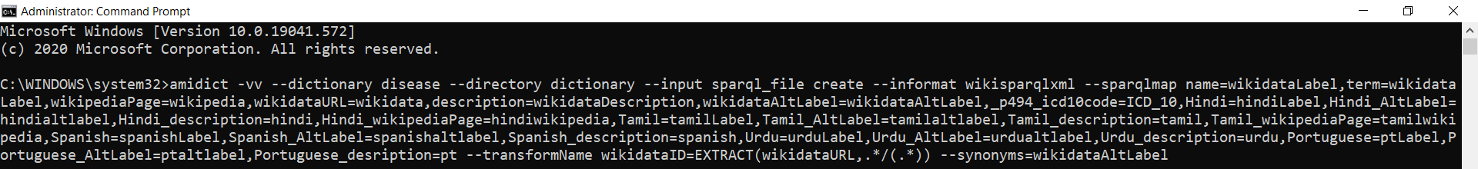
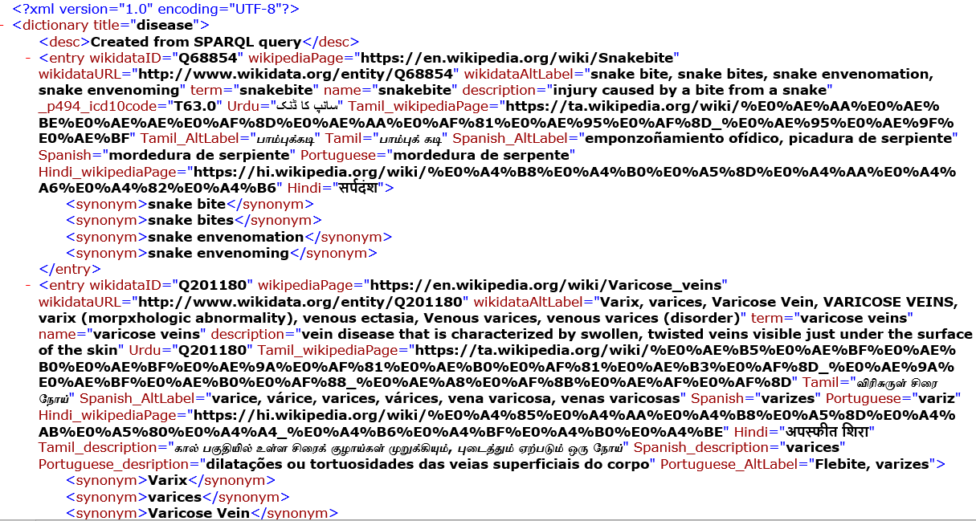
Creation of dictionary
Multilingual Dictionary

Slide 8



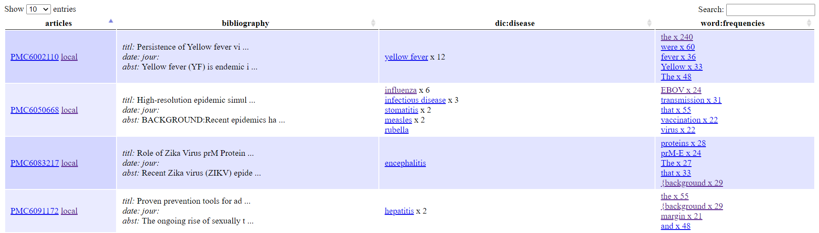

Slide 9

penVirus

